Slide 1
AIT 690-PROJECT PRESENTATION ON Quora INSINCERE QUESTIONS CLASSIFICATION
Team Name: TeamBots
Team Members: Abhishek Shambhu, Jeyamurugan Krishnakumar and Shreyans Singh

Slide 2
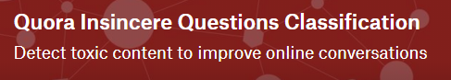
“
Quora helps you understand why the world works the way it does,
Why people behave the way they do …
GEORGE MASON UNIVERSITY

Slide 3
INTRODUCTION:
MOTIVATION
Kaggle Competition in NLP Classification
Difficult task to perform(use of NLP IN Machine Learning)
Previous Work showed use of just Machine Learning techniques and recent work shows use of different Neural Networks, however not much emphasis was given on processing which is crucial.
PROBLEM
In this competition, our task is to do natural language processing where the goal is to predict if a question’s intent is sincere.
GEORGE MASON UNIVERSITY

Slide 4
PROBLEM DESCRIPTION :
The problem with any major website today is how to deal with toxic and divisive content. Quora wants to head-on solve the problem and make their platform a place where users can safely share knowledge with the world.
Quora is a platform for people to learn from each other. At Quora, people can ask questions and connect with others who offer unique insights and quality answers.
A key challenge is to weed out false questions - those that are based on false premises, or that are intended to make statements rather than seeking useful answers.
In this competition, our task is to do natural language processing where the goal is to predict if a question’s intent is sincere.
GEORGE MASON UNIVERSITY

Slide 5
PROCESS:
Data Exploration
Model Building
Natural Language Processing (NLP)
Evaluating Results
GEORGE MASON UNIVERSITY

Slide 6
DATA DESCRIPTION :
An insincere problem is defined as a question that is intended to be a statement rather than a useful answer. Some features that indicate the problem of insincere:
Having a non-neutral tone:
- Having an exaggerated tone to underscore a point about a group of people.
- Are rhetorical and meant to imply a statement about a group of people.
Are disparaging or inflammatory:
- Suggest a discriminatory idea against a protected class of people, or seeks confirmation of a stereotype.
- Make disparaging attacks/insults against a specific person or group of people.
- Are based on an outlandish premise about a group of people.
- Are Disparaging against a characteristic that is not fixable and not measurable.
Aren’t grounded in reality:
- Based on false information, or contains absurd assumptions.
- Using sexual content (incest, bestiality, pedophilia) for shock value, and not to seek genuine answers.
GEORGE MASON UNIVERSITY

Slide 7
DATA DESCRIPTION :
Examples: (1) Why do Chinese hate Donald Trump?
(2) Do Americans that travel to Iran have a mental illness?
(3) Why is Quora so stupid?
(4) Why are religious people so rude?
(5) Why will Brian leave me?
(6) Why are Germans still allowed to have their own country?
(7) AreÂ JatÂ andÂ GujjarÂ girls beautiful?
(8) Why is Jinping the biggest serial religion murderer and rapist leader of the world after Mao?
(9) What is the best way to propose a girl without annoying her?
(10) What are some best college for aircraft propulsion(M.S)?
Basically, any question who’s intent is to anger, offend or inflame and no information can be gained from such questions need to be excluded from Quora’s platform.
GEORGE MASON UNIVERSITY

Slide 8
DATA DESCRIPTION (Continued) :
The training data includes the question that was asked, and whether it was identified as insincere (target=1). The ground-truth tag contains some noise: they are not guaranteed to be perfect.
Quora Train dataset shape: (1306122, 3), Quora Test dataset shape: (375806, 2)
DATA FIELDS:
Qid - unique question identifier
Question_text - Quora question text
Target - the value of the question labeled "insincere" is 1, otherwise 0
EMBEDDINGS:
GoogleNews-vectors-negative300
glove.840B.300d
Paragram_300_sl999
wiki-news-300d-1M
GEORGE MASON UNIVERSITY

Slide 9
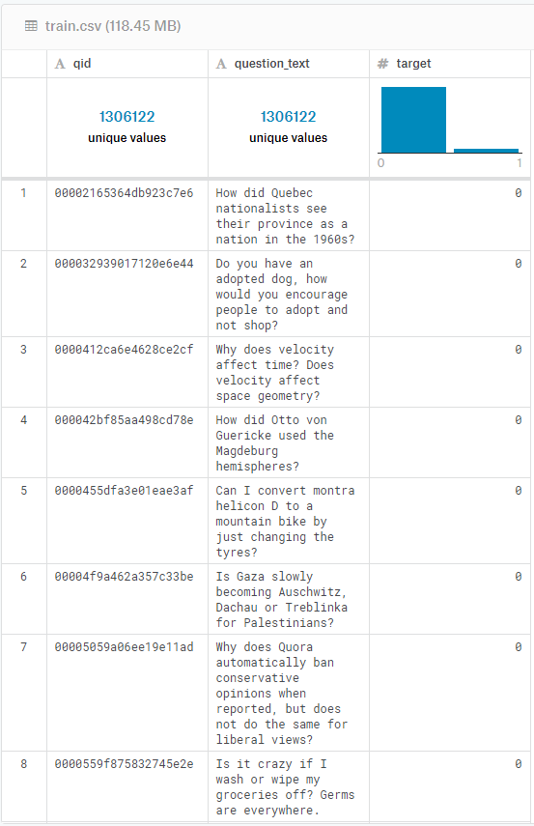
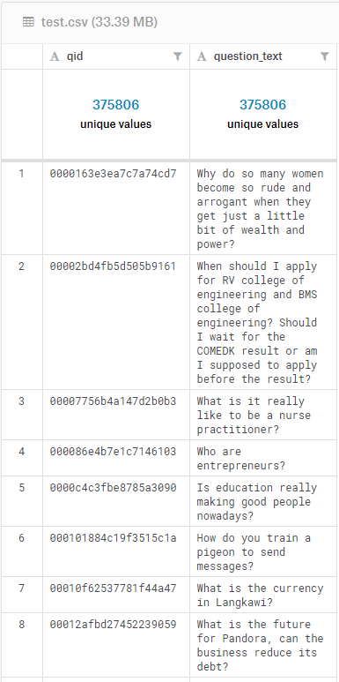
DATA DESCRIPTION (Continued) :
GEORGE MASON UNIVERSITY

Slide 10
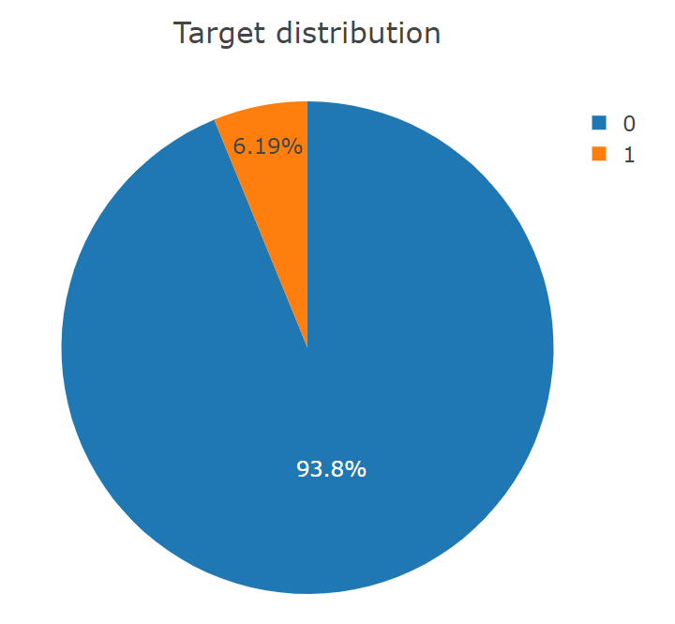
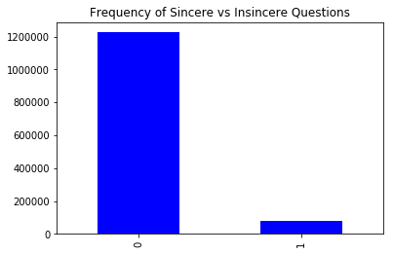
EXPECTED DIFFICULTIES (SINCERE/INSINCERE DISTRIBUTION FOR TRAINING DATA):
Difficulties:
Large Dataset
The training data has over 1.3 million records. So, we expected challenges in dealing with the large dataset.
Challenges may include running into memory errors and excessive processing times.
Imbalanced Dataset
The dataset is highly imbalanced, with only 6.19% of samples belonging to the target (insincere) class.
Solution:
To avoid excessive processing times, we used the Kaggle workspace.
Moreover, we also did some feature engineering since model optimization is also important.
And since it is an imbalanced dataset, we looked at the F1 score metric instead of accuracy to test our models.
Performance Metrics: F1 score, Confusion Matrix
1225312
80810
GEORGE MASON UNIVERSITY

Slide 11
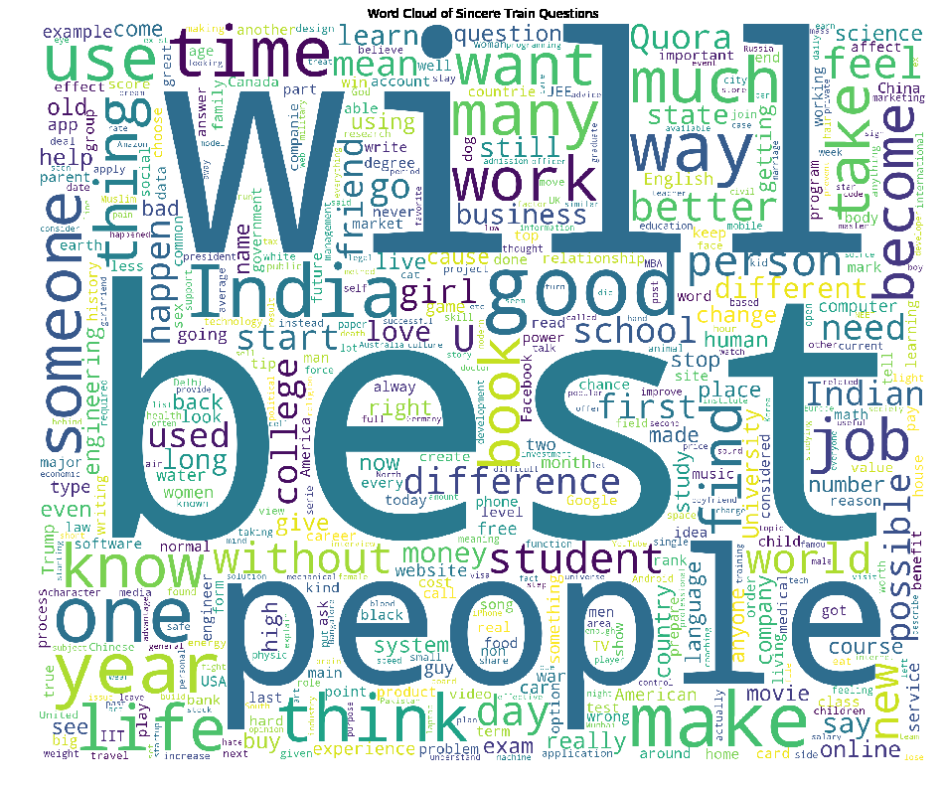
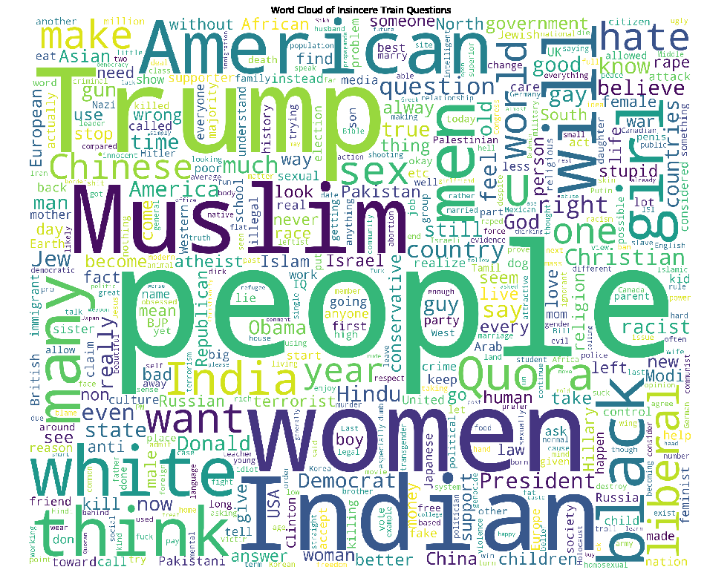
WORD CLOUD FOR SINCERE/INSINCERE QUESTIONS IN TRAIN DATASET:
GEORGE MASON UNIVERSITY

Slide 12
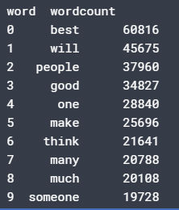
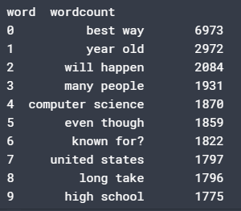
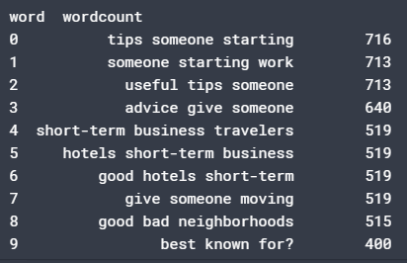
TOP 10 FREQUENT WORDS FROM SINCERE QUESTIONS WHEN DOING UNIGRAMS / BIGRAMS / TRIGRAMS:
UNIGRAMS
BIGRAMS
TRIGRAMS
GEORGE MASON UNIVERSITY

Slide 13
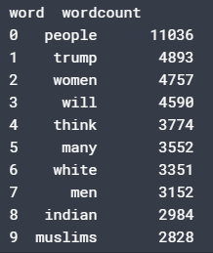
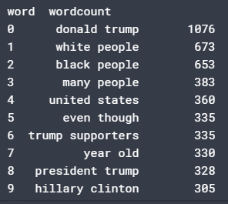
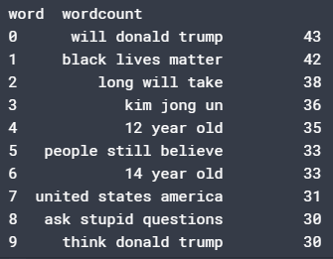
TOP 10 FREQUENT WORDS FROM INSINCERE QUESTIONS WHEN DOING UNIGRAMS / BIGRAMS / TRIGRAMS:
UNIGRAMS
BIGRAMS
TRIGRAMS
GEORGE MASON UNIVERSITY

Slide 14
A LOOK AT SOME OF THE FEATURES OF TRAIN DATA:
Number of Words in the text
Number of Unique Words in the text
Number of characters in the text
Number of stopwords in the text
Number of punctuations in the text
Number of upper case words in the text
Number of title words in the text
Average length of words in the text
NLP and TEXT PRE-PROCESSING TECHNIQUES PERFORMED:
Tokenization and Padding of sentences
N-grams feature addition
Stopwords removal
Word Vectorization feature addition (TF-IDF → Term frequency-inverse document frequency)
→ stripping accents (à, è, ù) → stripping punctuations
→ converting to lowercase → tokenizing
→ analyzer (word / char) → max features
→ sublinear tf (scaling)
GEORGE MASON UNIVERSITY

Slide 15
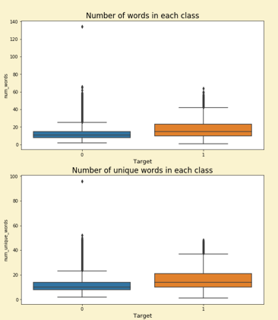
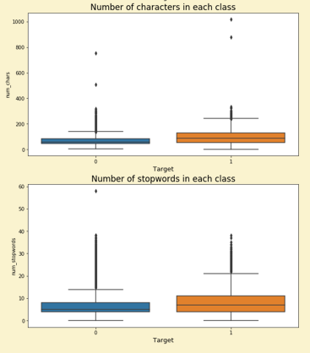
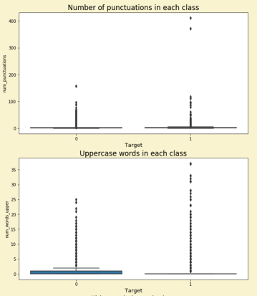
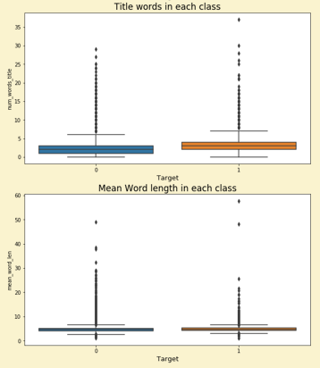
BOXPLOT VISUALIZATIONS:
GEORGE MASON UNIVERSITY

Slide 16
Basic Terminology
Logistic Regression - Logistic regression is the appropriate regression analysis to conduct when the dependent variable is binary. Like all regression analyses, the logistic regression is a predictive analysis. Logistic regression is used to describe data and to explain the relationship between one dependent binary variable and one or more nominal, ordinal, interval or ratio-level independent variables.
Bag of Words Approach - The bag-of-words model is a simplifying representation used in natural language processing and information retrieval (IR). In this model, a text (such as a sentence or a document) is represented as the bag (multiset) of its words, disregarding grammar and even word order but keeping multiplicity.
Term Frequency (TF) – It gives us the frequency of the word in each document in the corpus. It is the ratio of number of times the word appears in a document compared to the total number of words in that document. It increases as the number of occurrences of that word within the document increases. Each document has its own term frequency.
Inverse Term Frequency (IDF) – It used to calculate the weight of rare words across all documents in the corpus. The words that occur rarely in the corpus have a high IDF score. It is given by the equation below.
GEORGE MASON UNIVERSITY

Slide 17
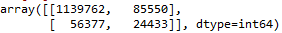
Baseline Model
Logistic Regression was used as the baseline model as Logistic Regression is one of the most simple and commonly used Machine Learning algorithms for two-class classification. It is easy to implement and can be used as the baseline for any binary classification problem.
We implemented simple Logistic Regression performing k=5 splits or 5-folds CV and applying the Logistic Regression classifier.
We got the following results for our model –
F1-score: 0.2561 and Accuracy: 0.8913
We have more than 94% as sincere and remaining as insincere which will give a higher accuracy even though all the values are classified as sincere.
The confusion matrix that we got is as follows –
GEORGE MASON UNIVERSITY

Slide 18
Examples where Baseline Model works well and not well
Correctly Classified Sincere Questions –
Do you have an adopted dog, how would you encourage people to adopt and not shop?
Why does velocity affect time? Does velocity affect space geometry?
Incorrectly Classified Sincere Questions –
What star were you born under?
What is the greatest amount of blood you can donate?
GEORGE MASON UNIVERSITY

Slide 19
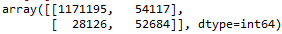
Improvement over Baseline Model
Logistic Regression with TF/IDF was used as the next model to increase our F1 score.
The TF-IDF Vectorizer will tokenize documents, learn the vocabulary and inverse document frequency weightings, and allow you to encode new documents.
We implemented simple Logistic Regression performing k=5 splits or 5-folds CV and applying the Logistic Regression classifier.
We got the following results for our model –
F1-score: 0.562 and Accuracy: 0.937.
The confusion matrix that we got is as follows –
GEORGE MASON UNIVERSITY

Slide 20
Examples where Logistic Regression Model with TF/IDF works well and not well
Questions that are incorrectly labeled ‘insincere’, are now correctly classified sincere –
What are the requirements to study and work in canada for international students ?
what is the function of charcoal mask blackhead remover mask ?
Questions that are now correctly classified insincere –
quora stupid moderators „they collapse my superior answers „how can i destroy their inferiority ?
Is to inhale cigarette to repent, even if your atheist?
GEORGE MASON UNIVERSITY

Slide 21
Naïve bayes modEL
Good Probabilistic Algorithm
Naive Bayes (NB) and Support Vector Machine (SVM) models are often used as baselines for other methods in text categorization and sentiment analysis research.
They claim that NB outperforms other structure sensitive methods.
A Naive Bayes classifier assumes that the presence of a particular feature in a class is unrelated to the presence of any other feature. Logistic Regression is vulnerable to overfitting.
Here, NB has a 0.551 score.
GEORGE MASON UNIVERSITY

Slide 22
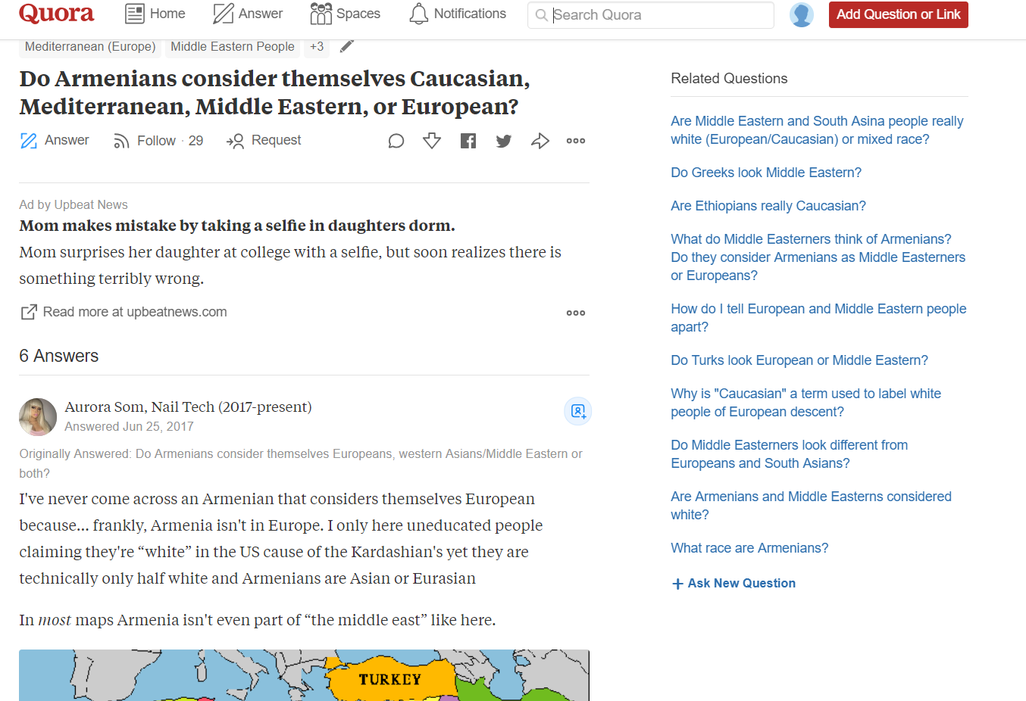
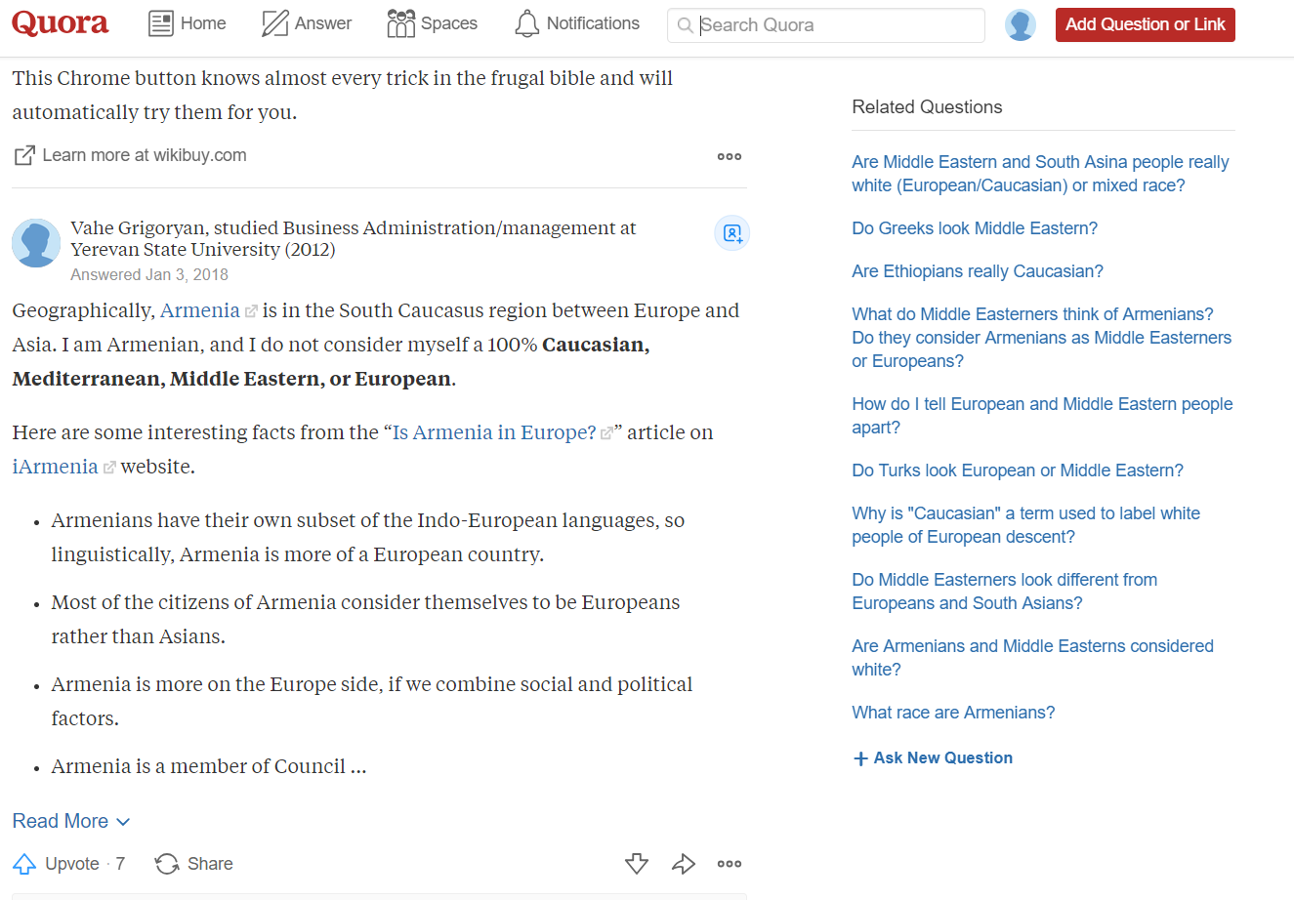
Example
In one of the questions - “Do Armenians consider themselves Europeans, western Asians/middle eastern or both?”, it was classified as Insincere.
GEORGE MASON UNIVERSITY

Slide 23
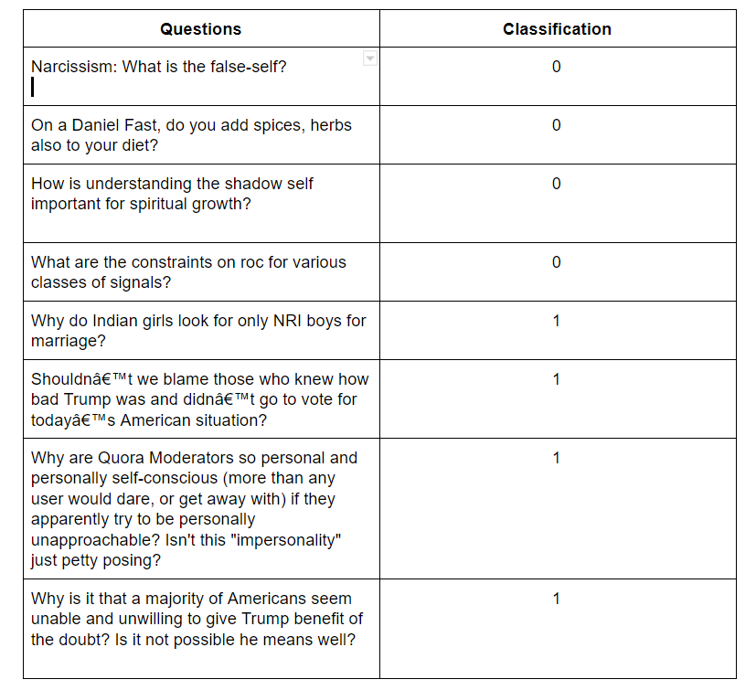
GEORGE MASON UNIVERSITY

Slide 24
NBSVM Model
NBSVM is an approach to text classification proposed by Wang and Manning¹ that takes a linear model such as SVM (or logistic regression) and infuses it with Bayesian probabilities by replacing word count features with Naive Bayes log-count ratios.
Despite its simplicity, NBSVM models have been shown to be both fast and powerful across a wide range of different text classification datasets.
NBSVM performs well on longer documents, for sentiment, topic and subjectivity classification
If implemented using Keras with embedding layers, model performs a lot better than this ( depending on GPU )
An F1 score of 0.62 is achieved.
GEORGE MASON UNIVERSITY

Slide 25
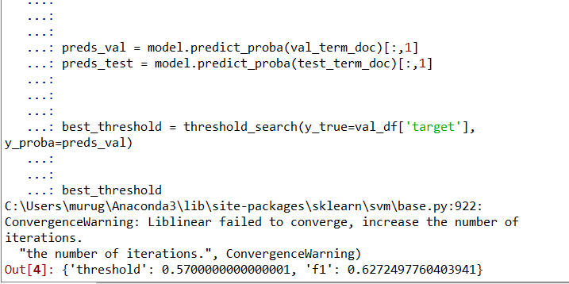
OTHER Model
RNN’s - Recurrent Neural Networks work just fine when we are dealing with short-term dependencies. (nothing to do with the context of the statement)
LSTMs have an edge over conventional feed-forward neural networks and RNN in many ways. This is because of their property of selectively remembering patterns for long durations of time.
GEORGE MASON UNIVERSITY

Slide 26
FINAL Results
We got the following results -
Models | F1 Score
Logistic Regression | 0.2561
Logistic Regression with TF-IDF | 0.562
Naïve Bayes | 0.551
NBSVM | 0.627
GEORGE MASON UNIVERSITY

Slide 27
Thank You
GEORGE MASON UNIVERSITY

